Slide 1

CMR Technical Campus Department of Information Technology
Major Project Stage-2 Review-1
Project Title: Transformer-Based Multilingual Language Identification from Text Inputs
Project Supervisor:​
Name:​ Mr.Ravi Regulagadda
Designation: Associate Professor
Presented By:​
Batch No: 13
H. No: 227R1A1210 Name: B.Venkatesh
H. No: 227R1A1219 Name: G.GopiChand
H. No: 217R1A1240 Name: MD.Khaleem
​

Slide 2
Index
Introduction/Overview
Existing System
Disadvantages
Proposed System
Advantages
Hardware and Software Requirements
Novelty of the project
Architecture
Modules
UML Diagrams

Slide 3
Introduction/Overview:​
Language serves as the cornerstone of human communication, shaping interactions in business, education, politics, and culture. In the digital era, multilingual communication is more prevalent than ever before, with over 4.5 billion people actively engaging on social media platforms that support dozens of languages. Identifying the correct language from user-generated text is critical for translation, sentiment analysis, and personalized services. With short forms, slang, and code-mixed content dominating online communication, automated multilingual language identification becomes indispensable for ensuring seamless interaction across global users.

Slide 4
Existing System:
In traditional systems, language identification was performed manually, where linguists and data processors carefully read text documents and determined the language based on their personal expertise and experience.
Experts relied heavily on script recognition and linguistic knowledge, identifying languages by observing writing systems such as Latin, Cyrillic, or Devanagari, along with grammar rules, vocabulary usage, and sentence structure.
The manual workflow included collecting text from various sources, closely examining it, verifying meanings using dictionaries or reference books, and finally classifying the text by manually assigning language labels.
The technology supporting traditional systems was limited to human cognitive abilities, with printed dictionaries and language references acting as the primary tools for verification and decision-making.
To partially assist manual efforts, basic rule-based techniques were sometimes used, including counting characters, analyzing letter distributions, and using n-gram frequency patterns to guess the language.
Despite these methods, traditional systems suffered from poor scalability, low accuracy, and slow processing speed, and they failed to handle short texts, ambiguous inputs, or code-mixed multilingual content effectively.

Slide 5
Disadvantages:
Manual reading and classification are extremely slow.
Humans may misclassify texts, especially short, ambiguous, or mixed-language inputs.
Processing large volumes of text is nearly impossible.
Rule-based systems cannot handle code-mixed, short, or noisy data effectively.
Requires skilled personnel for multilingual processing.
Cannot provide instant results for online applications.

Slide 6
Proposed System:
System Overview The proposed architecture presents an end-to-end workflow for transformer-based multilingual language identification, integrating data preparation, feature extraction, model evaluation, and deployment into a single framework.
Input Data & Preprocessing A multilingual text dataset containing short, informal, and code-mixed inputs is processed using NLP techniques such as tokenization, stop-word removal, and lemmatization, followed by EDA to analyze language distribution and token patterns.
Feature Extraction (MiniLM) Preprocessed text is converted into contextual vector embeddings using the MiniLM transformer model, which efficiently captures multilingual semantics while maintaining low computational cost.
Baseline & Proposed Models Baseline classifiers (DTC, KNN, NBC) are trained on MiniLM features for comparison, while the proposed Random Forest Classifier improves accuracy by handling high-dimensional features and reducing overfitting.
Deployment The trained model is deployed as a Flask-based web application with a simple UI, enabling real-time language prediction for multilingual text inputs.

Slide 7
Advantages:
Enables real-time identification of multiple languages in diverse contexts.
Provides high semantic accuracy with MiniLM embeddings while remaining computationally efficient.
Supports applications in translation services, multilingual chatbots, and cross-border communication platforms.

Slide 8
Software and Hardware Requirements:
Operating System –Windows / Linux
Front-End –HTML, CSS
Back-End – Python 3.12.0 with Flask framework
Frameworks / Libraries –Flask, Scikit-learn, Transformers (Hugging Face), PyTorch, Pandas, NumPy, Matplotlib, Seaborn, NLTK, LangDetect
Processor (CPU) –Intel i5 or higher
Memory (Storage) – 1TB HDD/512 SSD
RAM – 8 GB

Slide 9
Novelty of the Project:
This project lies in its hybrid and practical integration of transformer-based embeddings with classical machine learning, rather than relying solely on heavy end-to-end deep learning models.
Hybrid Architecture: Uses transformer-based MiniLM embeddings only for feature extraction and combines them with a Random Forest classifier, avoiding heavy end-to-end deep learning while still achieving high accuracy.
Efficiency with Performance: MiniLM’s lightweight distilled design delivers semantic-rich representations at low computational cost, making the system faster and more practical than large multilingual transformers.
Robust Handling of Real-World Text: Effectively detects languages in short, informal, and code-mixed text, where traditional n-gram, rule-based, and basic ANN models typically fail.
Research-to-Deployment Integration: Goes beyond theory by providing baseline comparisons (DTC, KNN, GNB vs. RFC) and a real-time Flask web application, proving real-world applicability rather than just experimental results

Slide 10
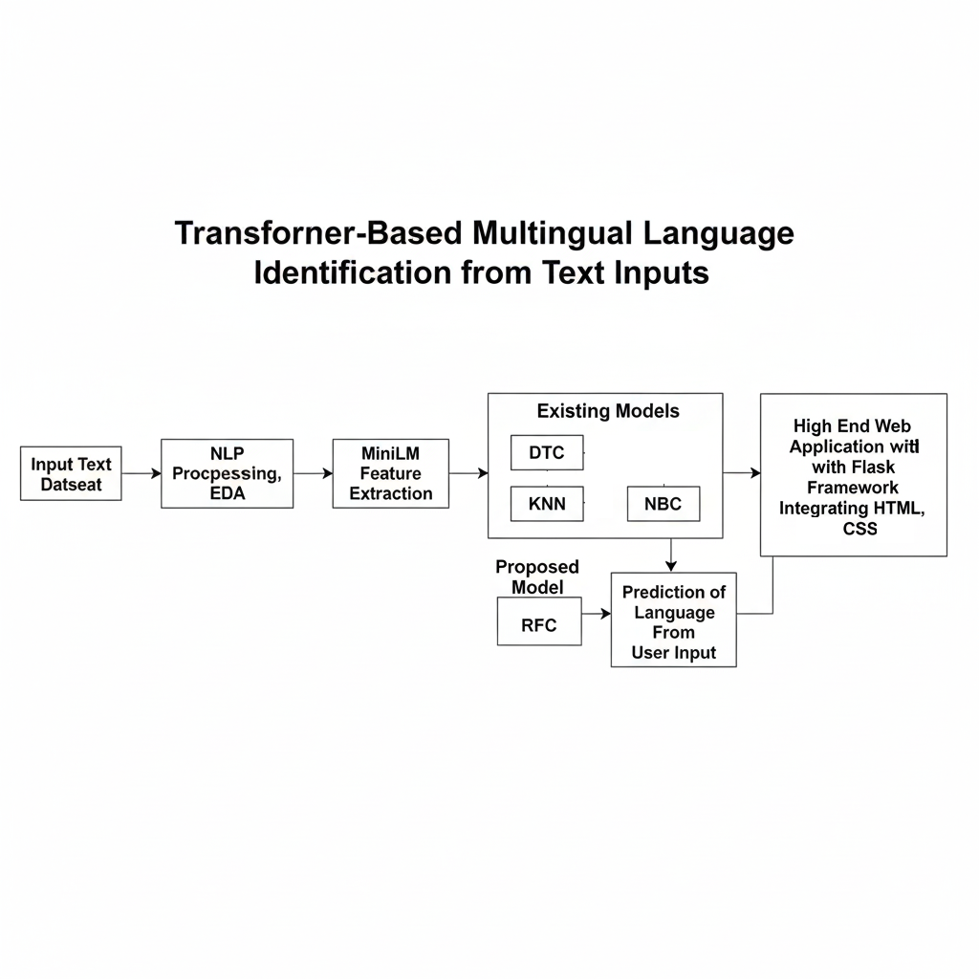
Design/Architecture​:

Slide 11
Modules:
1.Dataset Loading Module
Handles uploading and reading multilingual text datasets (CSV/TSV). It extracts text samples and corresponding language labels for further processing.
2. Text Preprocessing Module
Cleans and normalizes raw text using tokenization, stop-word removal, lemmatization, and noise filtering. This ensures consistent and meaningful input for feature extraction.
3. Exploratory Data Analysis (EDA) Module
Analyzes language distribution, word frequencies, document length, POS tags, and bigrams using visual tools like WordClouds and frequency plots to understand dataset characteristics.
4. MiniLM Feature Extraction Module
Uses the transformer-based MiniLM model to convert preprocessed text into dense semantic embeddings that capture contextual and cross-lingual information efficiently.

Slide 12
5. Baseline Classification Module
Implements traditional classifiers—Decision Tree, K-Nearest Neighbors, and Gaussian Naive Bayes—trained on MiniLM embeddings to provide performance benchmarks.
6. Proposed Random Forest Classification Module
Acts as the main prediction engine. It uses ensemble learning on MiniLM features to achieve higher accuracy, robustness, and better handling of short or code-mixed text.
7. Model Training and Evaluation Module
Splits data into training/testing sets, trains all models, and evaluates them using accuracy, precision, recall, and F1-score.
8. Visualization and Comparison Module
Generates graphs and charts to compare model performances and present results clearly to the user.
9. Web Application Deployment Module
Deploys the trained model using Flask with HTML/CSS, enabling real-time language detection through a user-friendly interface.

Slide 13
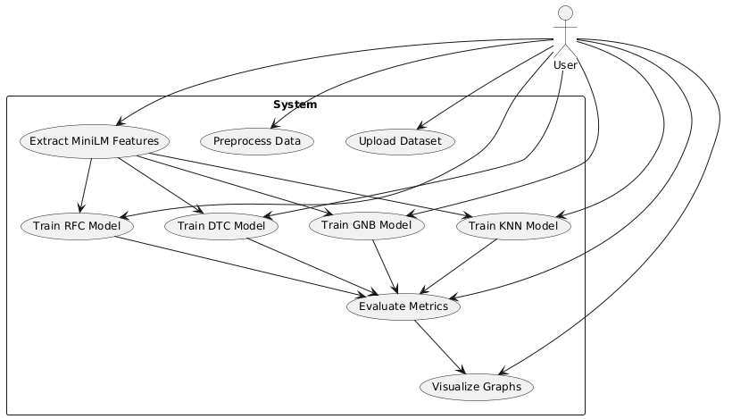
UML Diagrams:-
Use Case Diagram

Slide 14
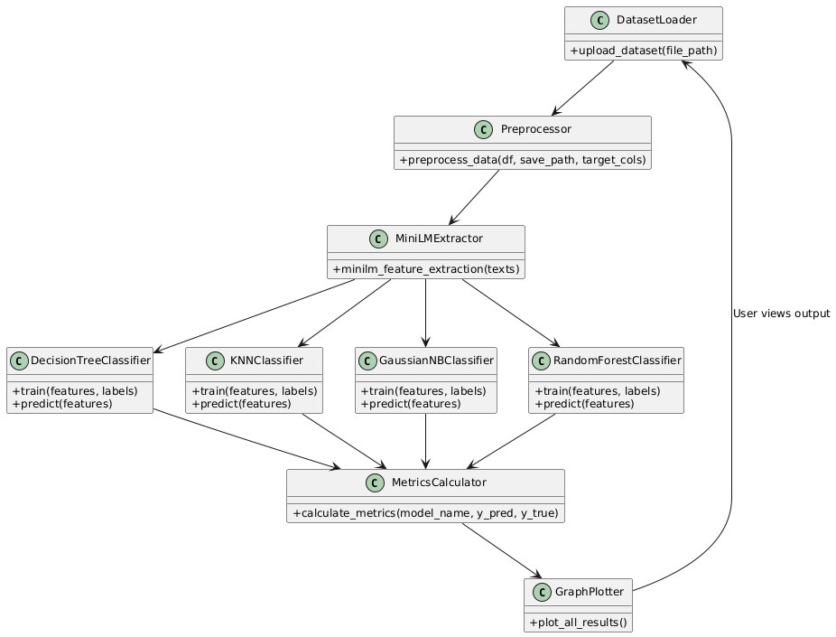
Class Diagram

Slide 15
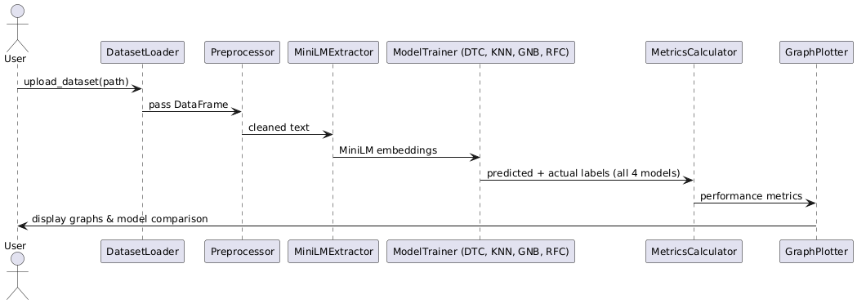
Sequence Diagram

Slide 16
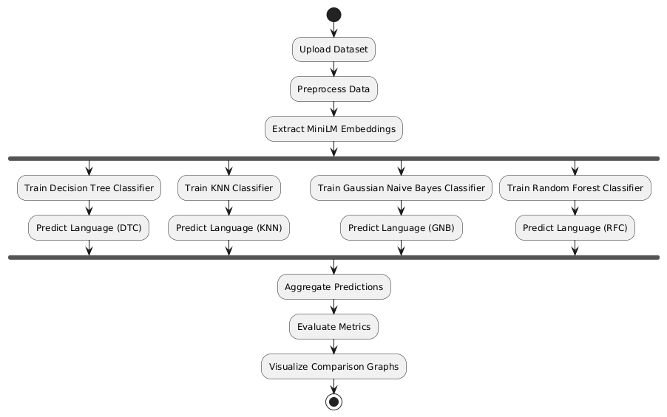
Activity Diagram

Slide 17
THANK YOU

